Slide 1
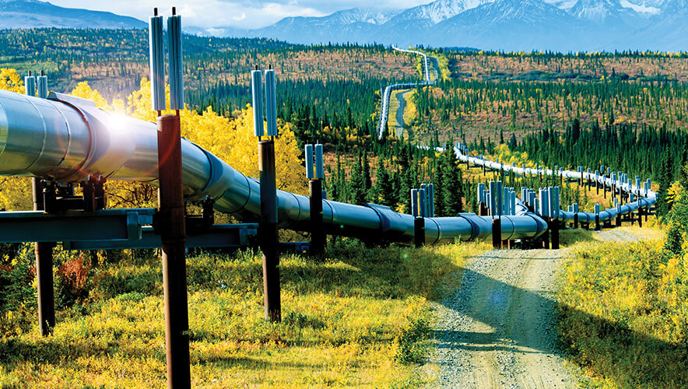


An Innovative Methodology for HDD Pipeline Crossings
In partnership with YPAC and CEPA
480: Multidisciplinary Industry Design Project
April 19th, 2021
Maeve Buchan | Emma Selleck | Lucia Beram

Slide 2

Agenda
1
7
Original Scope and Problem Statement
Geophysics Research
8
2
Proposed Solution
Scope Progression
9
3
Wapiti River Crossing
Finalized Project Scope and Statement
10
Project Validation
4
Project Research
11
Project Value and Conclusions
5
Idea Generation and Decision Making
12
Project Recommendations and Acknowledgements
6
Evolution of Project Solution
1

Slide 3





Original Scope and Problem Statement
Trenched vs Trenchless
High Design and Construction Costs
Find Innovative ways to reduce costs
Maintain Safety
Focus on HDD, Microtunneling, Auger Boring
2
Notes:
Lucia

Slide 4
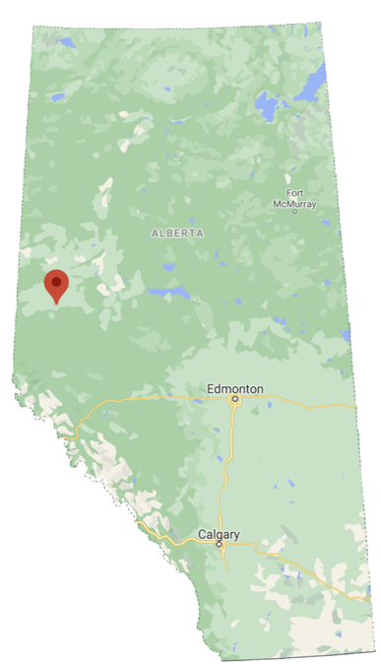






Scope Progression
Focus on HDD technique
Most opportunities for improvement
HDD
Crossing the Wapiti River, Grand Prairie
Provided design specifications and expectations
Pseudo Project
Focus on construction process
Less emphasis on clearing and site remediation
Refined Scope
3
Notes:
Lucia

Slide 5
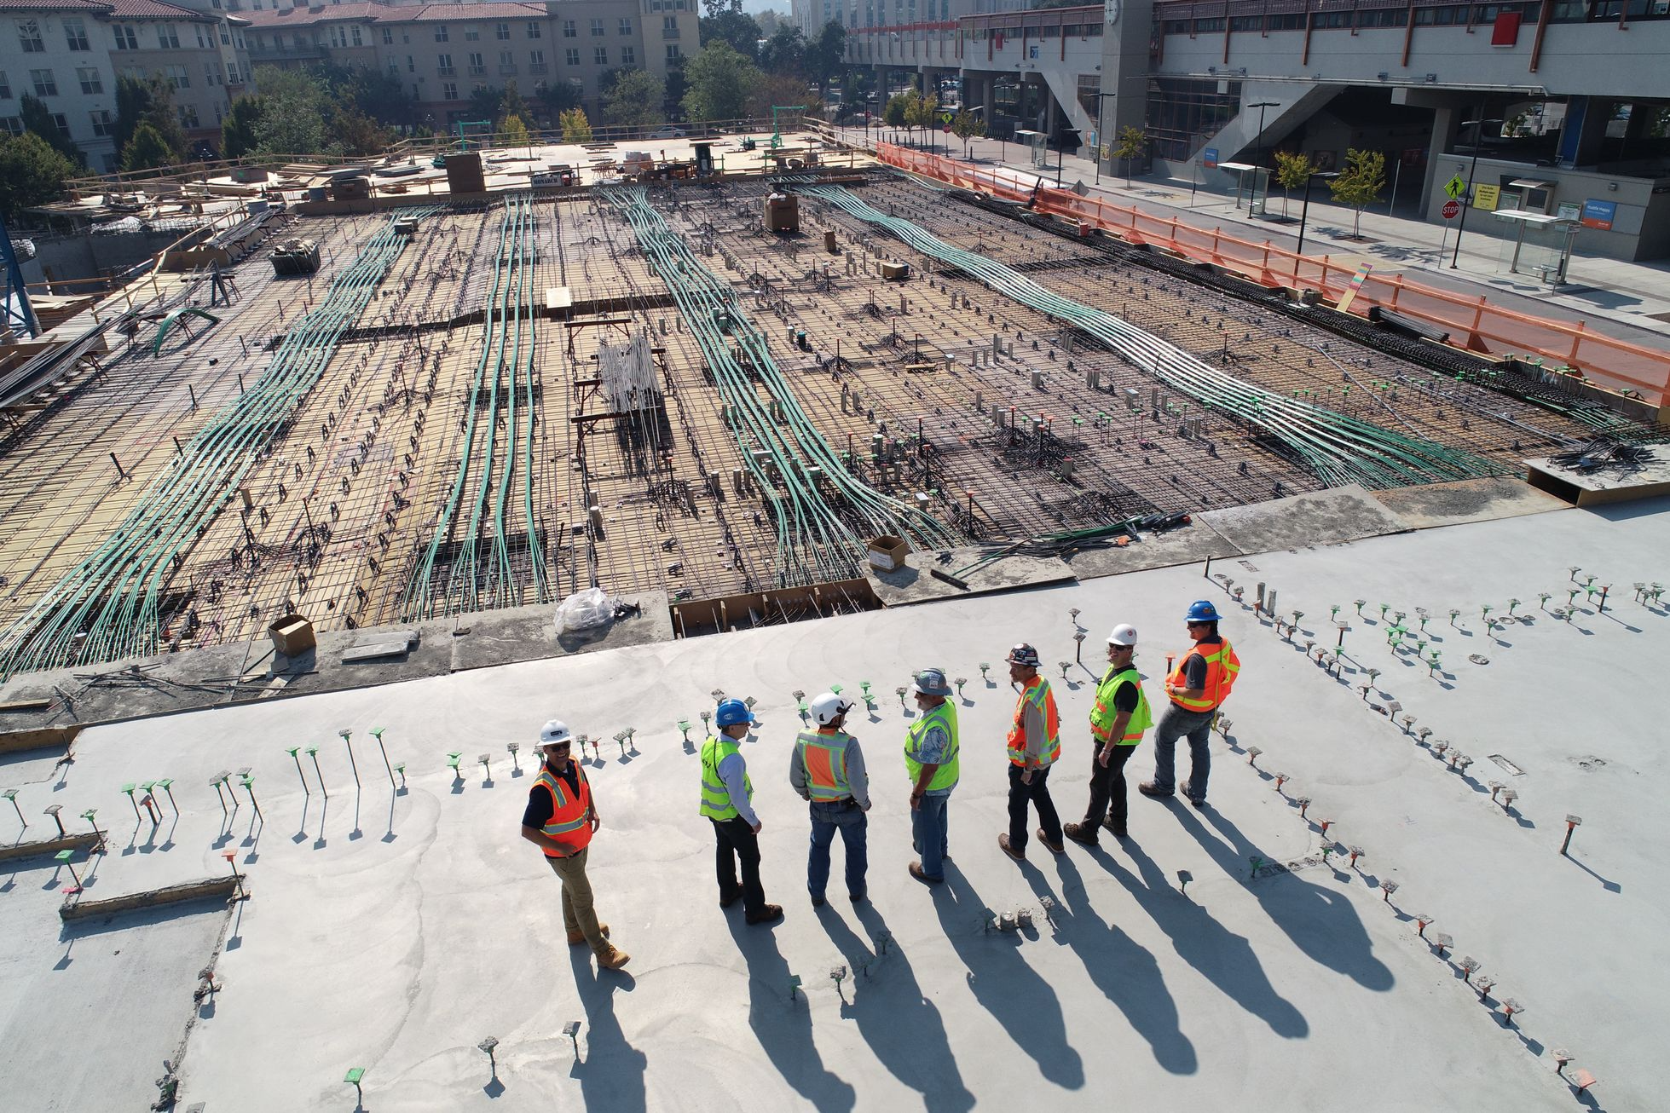
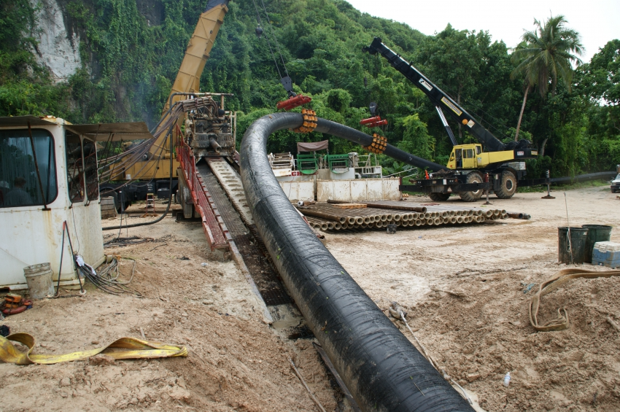
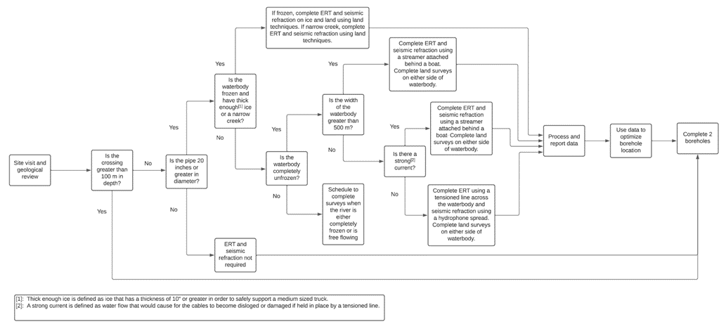
Project Scope &
Problem Statement
Detailed Wapiti River Crossing
Improve HDD Process
Final Result
Design completed by April 2021
Designed to be in service by April 2022
Cater to Grand Prairie, Alberta climate and geotechnical considerations
Improve design efficiency
Reduce construction costs
Maintain safety
Rendered Design (AutoPIPE)
2D Pipe Profile
Economic Analysis
Construction Timeline
Recommendations which can apply to any HDD crossing
4
Notes:
Lucia

Slide 6
Project Research
Construction Steps
Timelines of Each Process
Determine steps
Safety issues
Permit requirements
21 stakeholders contacted
Time requirements
Average delays
Costs of Processes
Drilling Fluid
Required equipment
Labour costs
Cost of complications
Purchasing costs
Disposal costs
Methods of disposal
Current innovations
5
Notes:
Maeve

Slide 7
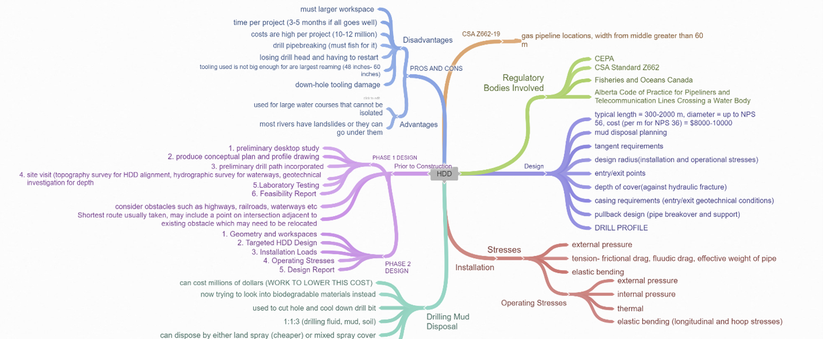
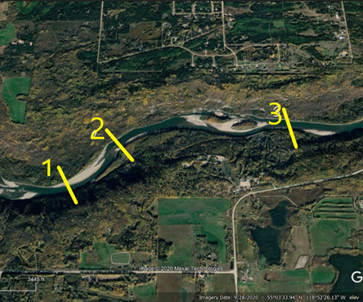
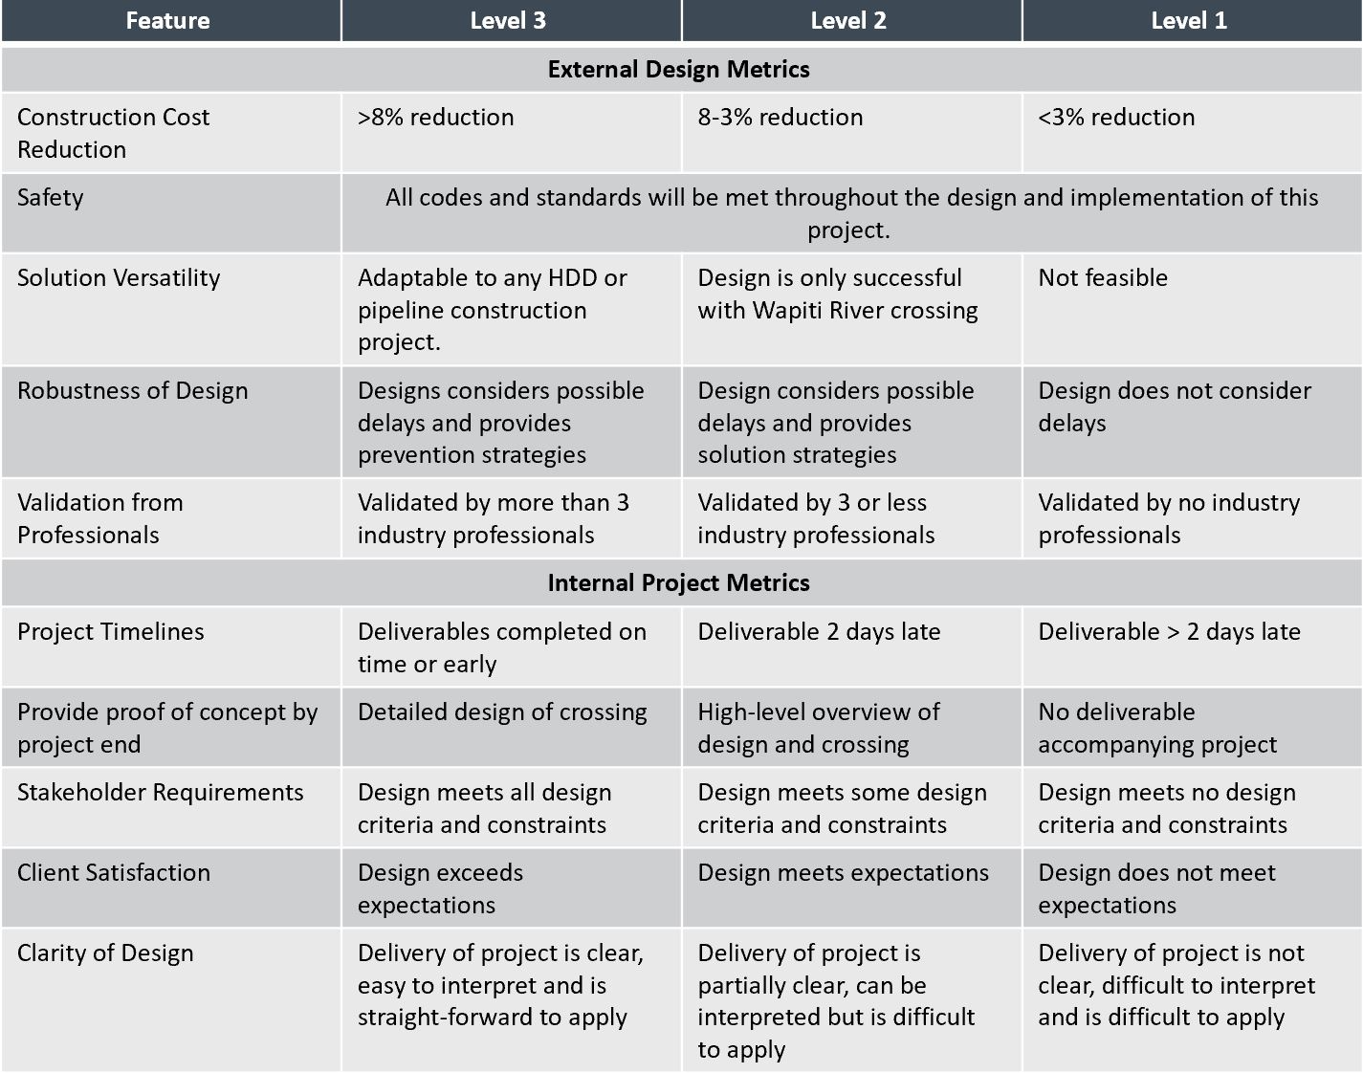
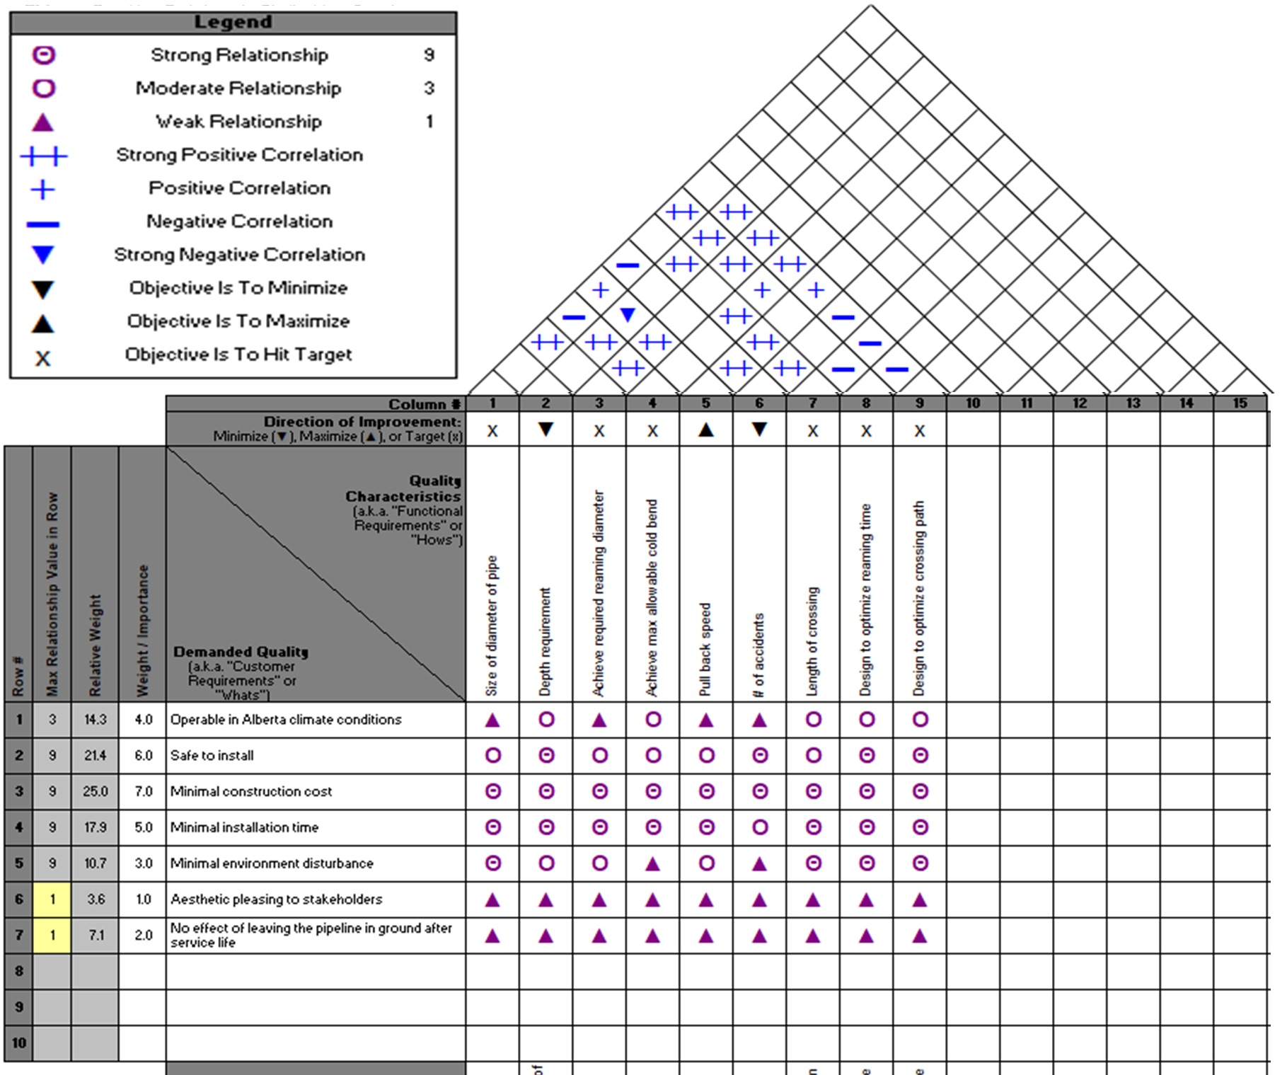
Idea Generation & Decision Making
________________________________________________
Cost Solution
Crossing Location
Functional Requirements
Project Metrics
6
6
Notes:
Maeve

Slide 8
Idea Generation & Decision Making
________________________________________________
Cost Solution
Crossing Location
Functional Requirements
Project Metrics
7
6
Notes:
Maeve

Slide 9
Idea Generation & Decision Making
________________________________________________
Cost Solution
Crossing Location
Functional Requirements
Project Metrics
8
6
Notes:
Maeve

Slide 10
Idea Generation & Decision Making
________________________________________________
Cost Solution
Crossing Location
Functional Requirements
Project Metrics
9
6
Notes:
Maeve

Slide 11
Idea Generation & Decision Making
________________________________________________
Cost Solution
Crossing Location
Functional Requirements
Project Metrics
6
10
Notes:
Maeve

Slide 12


Evolution of Project Solution
Decision Making
Drilling and reaming selected as the prime oportunities for cost reduction
Ground Investigation Selected as New Area of Research
Meeting with Paul Kelly
Discovered that unknown subsurface conditions pose major limitations to HDD
Idea Generation
FMEA Conducted on HDD Crossings
Confirmed majority of HDD failure modes are tied to unknown subsurface conditions
11
Notes:
Maeve

Slide 13
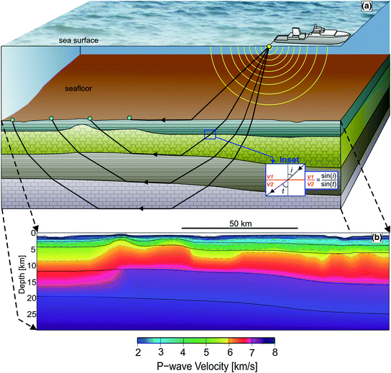

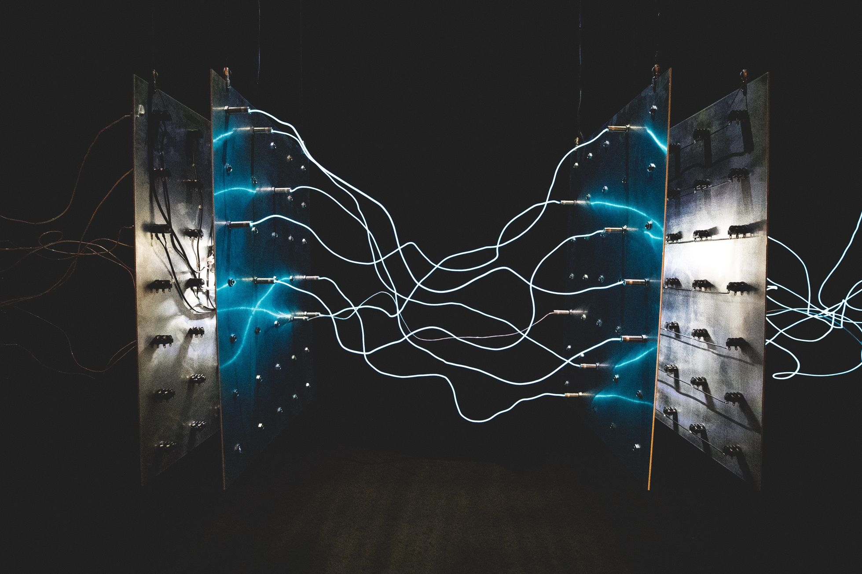
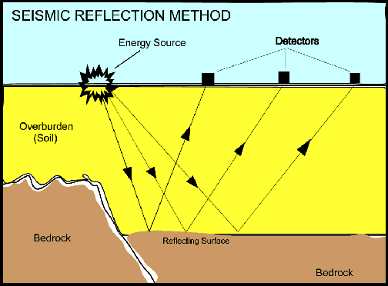
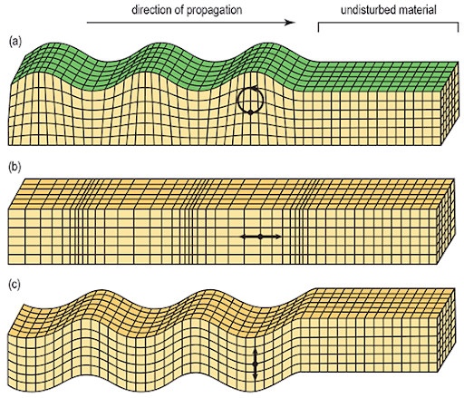
Uses Snell’s Law
Equipment includes seismic source and geophones/hydrophones
Measures time it takes for the refracted waves to return to the surface
Seismic Refraction
Geophysics Research
Seismic Reflection
Electrical Resistivity Tomography (ERT)
Similar to seismic refraction and refraction, but uses lower frequency waves
Cost effective for land applications
Expensive for water applications
Similar to seismic refraction, but measures the time it takes for the reflected wave to return to the surface
Waves reflect off different layers, but cannot tell what the layers are
Similar to seismic refraction and refraction, but uses lower frequency waves
Cost effective for land applications
Expensive for water applications
Multichannel Analysis of Surface Waves (MASW)
12
Notes:
These 4 methods were selected to be researched for determining subsurface conditions from the guidance of Sallie Vest, geologist working for ExxonMobil, and because they all had water applications.
Seismic Refraction:
Uses the refraction of seismic waves to determine subsurface conditions
Method uses Snell’s law which outlines the relationship between wave angles and refraction of waves when moving through different kinds of soil
Equipment includes a seismic source (sledgehammer on a plate or small explosives) and geophones for land and hydrophones for water
Method measures the time it takes for the waves to return to the surface
Seismic Reflection:
Similar to seismic refraction, but measures the time it takes for the reflected wave (not the refracted wave) to travel through the ground and back to surface
This method reflects off of different layers, but cannot tell what the layers are, just where they occur
Additionally, both these seismic methods are well suited for water applications
MASW:
Again, uses surface waves to determine ground stiffness, therefore similar to seismic reflection and refraction, but, uses lower frequency waves and can be cost effective for land applications
The downside to this method is that underwater MASW is not commonly used in industry and is very expensive. There are only 2 companies in north America that are completing research on this method.
ERT:
Maps the subsurface conditions by measuring the apparent electrical resistivity
Resistivity can vary due to the water content and composition of the soil
Equipment required is a pair of current electrodes to inject electrical current into the earth and also a pair of potential electrodes to measure the potential difference
This method is useful for determining areas that contain granular material which can lead to borehole instability or loss of fluid into the formation
After completing this research and meeting with industry professionals, it was concluded that ERT and seismic refraction are well suited for HDD water crossing applications. In addition, a research paper was found that advised these two methods be used together as they are very complimentary. ERT can be used to determine soil profiles and can also the bedrock profile if there is a contrast in electrical resistivity between the bedrock and overburden. When there is not significant contrast and the bedrock layer is difficult to location, that is when seismic refraction can be used to validate the bedrock profile.

Slide 14
Uses Snell’s Law
Equipment includes seismic source and geophones/hydrophones
Measures time it takes for the refracted waves to return to the surface
Seismic Refraction
Geophysics Research
Seismic Reflection
Electrical Resistivity Tomography (ERT)
Similar to seismic refraction and refraction, but uses lower frequency waves
Cost effective for land applications
Expensive for water applications
Similar to seismic refraction, but measures the time it takes for the reflected wave to return to the surface
Waves reflect off different layers, but cannot tell what the layers are
Similar to seismic refraction and refraction, but uses lower frequency waves
Cost effective for land applications
Expensive for water applications
Multichannel Analysis of Surface Waves (MASW)
13
Notes:
These 4 methods were selected to be researched for determining subsurface conditions from the guidance of Sallie Vest, geologist working for ExxonMobil, and because they all had water applications.
Seismic Refraction:
Uses the refraction of seismic waves to determine subsurface conditions
Method uses Snell’s law which outlines the relationship between wave angles and refraction of waves when moving through different kinds of soil
Equipment includes a seismic source (sledgehammer on a plate or small explosives) and geophones for land and hydrophones for water
Method measures the time it takes for the waves to return to the surface
Seismic Reflection:
Similar to seismic refraction, but measures the time it takes for the reflected wave (not the refracted wave) to travel through the ground and back to surface
This method reflects off of different layers, but cannot tell what the layers are, just where they occur
Additionally, both these seismic methods are well suited for water applications
MASW:
Again, uses surface waves to determine ground stiffness, therefore similar to seismic reflection and refraction, but, uses lower frequency waves and can be cost effective for land applications
The downside to this method is that underwater MASW is not commonly used in industry and is very expensive. There are only 2 companies in north America that are completing research on this method.
ERT:
Maps the subsurface conditions by measuring the apparent electrical resistivity
Resistivity can vary due to the water content and composition of the soil
Equipment required is a pair of current electrodes to inject electrical current into the earth and also a pair of potential electrodes to measure the potential difference
This method is useful for determining areas that contain granular material which can lead to borehole instability or loss of fluid into the formation
After completing this research and meeting with industry professionals, it was concluded that ERT and seismic refraction are well suited for HDD water crossing applications. In addition, a research paper was found that advised these two methods be used together as they are very complimentary. ERT can be used to determine soil profiles and can also the bedrock profile if there is a contrast in electrical resistivity between the bedrock and overburden. When there is not significant contrast and the bedrock layer is difficult to location, that is when seismic refraction can be used to validate the bedrock profile.

Slide 15
Uses Snell’s Law
Equipment includes seismic source and geophones/hydrophones
Measures time it takes for the refracted waves to return to the surface
Seismic Refraction
Geophysics Research
Seismic Reflection
Electrical Resistivity Tomography (ERT)
Similar to seismic refraction and refraction, but uses lower frequency waves
Cost effective for land applications
Expensive for water applications
Similar to seismic refraction, but measures the time it takes for the reflected wave to return to the surface
Waves reflect off different layers, but cannot tell what the layers are
Similar to seismic refraction and refraction, but uses lower frequency waves
Cost effective for land applications
Expensive for water applications
Multichannel Analysis of Surface Waves (MASW)
14
Notes:
These 4 methods were selected to be researched for determining subsurface conditions from the guidance of Sallie Vest, geologist working for ExxonMobil, and because they all had water applications.
Seismic Refraction:
Uses the refraction of seismic waves to determine subsurface conditions
Method uses Snell’s law which outlines the relationship between wave angles and refraction of waves when moving through different kinds of soil
Equipment includes a seismic source (sledgehammer on a plate or small explosives) and geophones for land and hydrophones for water
Method measures the time it takes for the waves to return to the surface
Seismic Reflection:
Similar to seismic refraction, but measures the time it takes for the reflected wave (not the refracted wave) to travel through the ground and back to surface
This method reflects off of different layers, but cannot tell what the layers are, just where they occur
Additionally, both these seismic methods are well suited for water applications
MASW:
Again, uses surface waves to determine ground stiffness, therefore similar to seismic reflection and refraction, but, uses lower frequency waves and can be cost effective for land applications
The downside to this method is that underwater MASW is not commonly used in industry and is very expensive. There are only 2 companies in north America that are completing research on this method.
ERT:
Maps the subsurface conditions by measuring the apparent electrical resistivity
Resistivity can vary due to the water content and composition of the soil
Equipment required is a pair of current electrodes to inject electrical current into the earth and also a pair of potential electrodes to measure the potential difference
This method is useful for determining areas that contain granular material which can lead to borehole instability or loss of fluid into the formation
After completing this research and meeting with industry professionals, it was concluded that ERT and seismic refraction are well suited for HDD water crossing applications. In addition, a research paper was found that advised these two methods be used together as they are very complimentary. ERT can be used to determine soil profiles and can also the bedrock profile if there is a contrast in electrical resistivity between the bedrock and overburden. When there is not significant contrast and the bedrock layer is difficult to location, that is when seismic refraction can be used to validate the bedrock profile.

Slide 16
Uses Snell’s Law
Equipment includes seismic source and geophones/hydrophones
Measures time it takes for the refracted waves to return to the surface
Seismic Refraction
Geophysics Research
Seismic Reflection
Electrical Resistivity Tomography (ERT)
Measures apparent electrical resistivity
Resistivity varies due to water content and composition of the soil
Equipment includes current electrodes and potential electrodes
Similar to seismic refraction, but measures the time it takes for the reflected wave to return to the surface
Waves reflect off different layers, but cannot tell what the layers are
Similar to seismic refraction and refraction, but uses lower frequency waves
Cost effective for land applications
Expensive for water applications
Multichannel Analysis of Surface Waves (MASW)
15
Notes:
These 4 methods were selected to be researched for determining subsurface conditions from the guidance of Sallie Vest, geologist working for ExxonMobil, and because they all had water applications.
Seismic Refraction:
Uses the refraction of seismic waves to determine subsurface conditions
Method uses Snell’s law which outlines the relationship between wave angles and refraction of waves when moving through different kinds of soil
Equipment includes a seismic source (sledgehammer on a plate or small explosives) and geophones for land and hydrophones for water
Method measures the time it takes for the waves to return to the surface
Seismic Reflection:
Similar to seismic refraction, but measures the time it takes for the reflected wave (not the refracted wave) to travel through the ground and back to surface
This method reflects off of different layers, but cannot tell what the layers are, just where they occur
Additionally, both these seismic methods are well suited for water applications
MASW:
Again, uses surface waves to determine ground stiffness, therefore similar to seismic reflection and refraction, but, uses lower frequency waves and can be cost effective for land applications
The downside to this method is that underwater MASW is not commonly used in industry and is very expensive. There are only 2 companies in north America that are completing research on this method.
ERT:
Maps the subsurface conditions by measuring the apparent electrical resistivity
Resistivity can vary due to the water content and composition of the soil
Equipment required is a pair of current electrodes to inject electrical current into the earth and also a pair of potential electrodes to measure the potential difference
This method is useful for determining areas that contain granular material which can lead to borehole instability or loss of fluid into the formation
After completing this research and meeting with industry professionals, it was concluded that ERT and seismic refraction are well suited for HDD water crossing applications. In addition, a research paper was found that advised these two methods be used together as they are very complimentary. ERT can be used to determine soil profiles and can also the bedrock profile if there is a contrast in electrical resistivity between the bedrock and overburden. When there is not significant contrast and the bedrock layer is difficult to location, that is when seismic refraction can be used to validate the bedrock profile.

Slide 17
Uses Snell’s Law
Equipment includes seismic source and geophones/hydrophones
Measures time it takes for the refracted waves to return to the surface
Seismic Refraction
Geophysics Research
Seismic Reflection
Electrical Resistivity Tomography (ERT)
Similar to seismic refraction and refraction, but uses lower frequency waves
Cost effective for land applications
Expensive for water applications
Similar to seismic refraction, but measures the time it takes for the reflected wave to return to the surface
Waves reflect off different layers, but cannot tell what the layers are
Similar to seismic refraction and refraction, but uses lower frequency waves
Cost effective for land applications
Expensive for water applications
Multichannel Analysis of Surface Waves (MASW)
16
Notes:
These 4 methods were selected to be researched for determining subsurface conditions from the guidance of Sallie Vest, geologist working for ExxonMobil, and because they all had water applications.
Seismic Refraction:
Uses the refraction of seismic waves to determine subsurface conditions
Method uses Snell’s law which outlines the relationship between wave angles and refraction of waves when moving through different kinds of soil
Equipment includes a seismic source (sledgehammer on a plate or small explosives) and geophones for land and hydrophones for water
Method measures the time it takes for the waves to return to the surface
Seismic Reflection:
Similar to seismic refraction, but measures the time it takes for the reflected wave (not the refracted wave) to travel through the ground and back to surface
This method reflects off of different layers, but cannot tell what the layers are, just where they occur
Additionally, both these seismic methods are well suited for water applications
MASW:
Again, uses surface waves to determine ground stiffness, therefore similar to seismic reflection and refraction, but, uses lower frequency waves and can be cost effective for land applications
The downside to this method is that underwater MASW is not commonly used in industry and is very expensive. There are only 2 companies in north America that are completing research on this method.
ERT:
Maps the subsurface conditions by measuring the apparent electrical resistivity
Resistivity can vary due to the water content and composition of the soil
Equipment required is a pair of current electrodes to inject electrical current into the earth and also a pair of potential electrodes to measure the potential difference
This method is useful for determining areas that contain granular material which can lead to borehole instability or loss of fluid into the formation
After completing this research and meeting with industry professionals, it was concluded that ERT and seismic refraction are well suited for HDD water crossing applications. In addition, a research paper was found that advised these two methods be used together as they are very complimentary. ERT can be used to determine soil profiles and can also the bedrock profile if there is a contrast in electrical resistivity between the bedrock and overburden. When there is not significant contrast and the bedrock layer is difficult to location, that is when seismic refraction can be used to validate the bedrock profile.

Slide 18
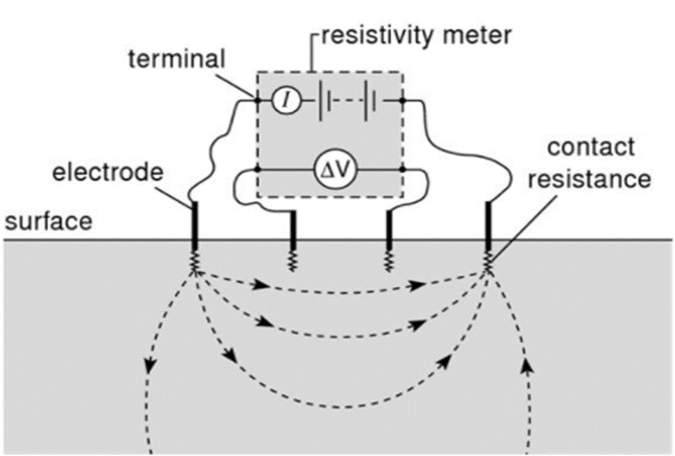
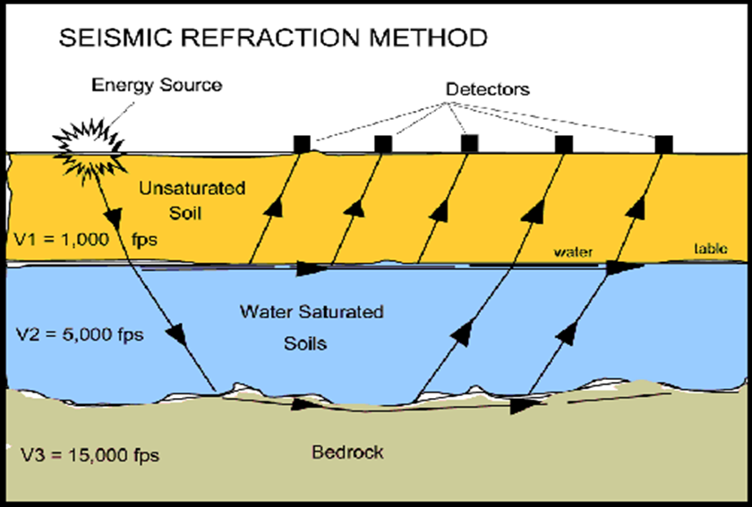
ERT and Seismic Refraction
Land Applications
ERT Current Electrodes and Potential Electrodes
Seismic Refraction Source with Geophones
17
Notes:
These can be done in any season

Slide 19
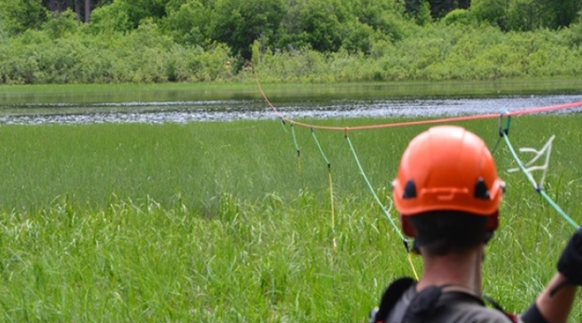
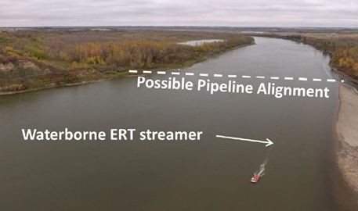
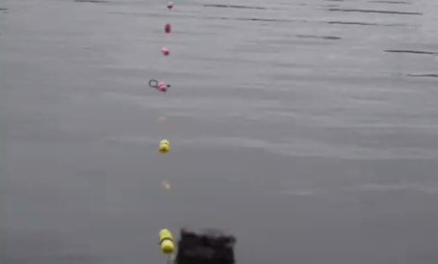
ERT and Seismic Refraction
Water Applications
ERT Cable Attached to Tensioned Rope
Boat Method
Hydrophone Spread
18
Notes:
Mention that the seismic source differs and is often a marine airgun or a low energy acoustic type source

Slide 20
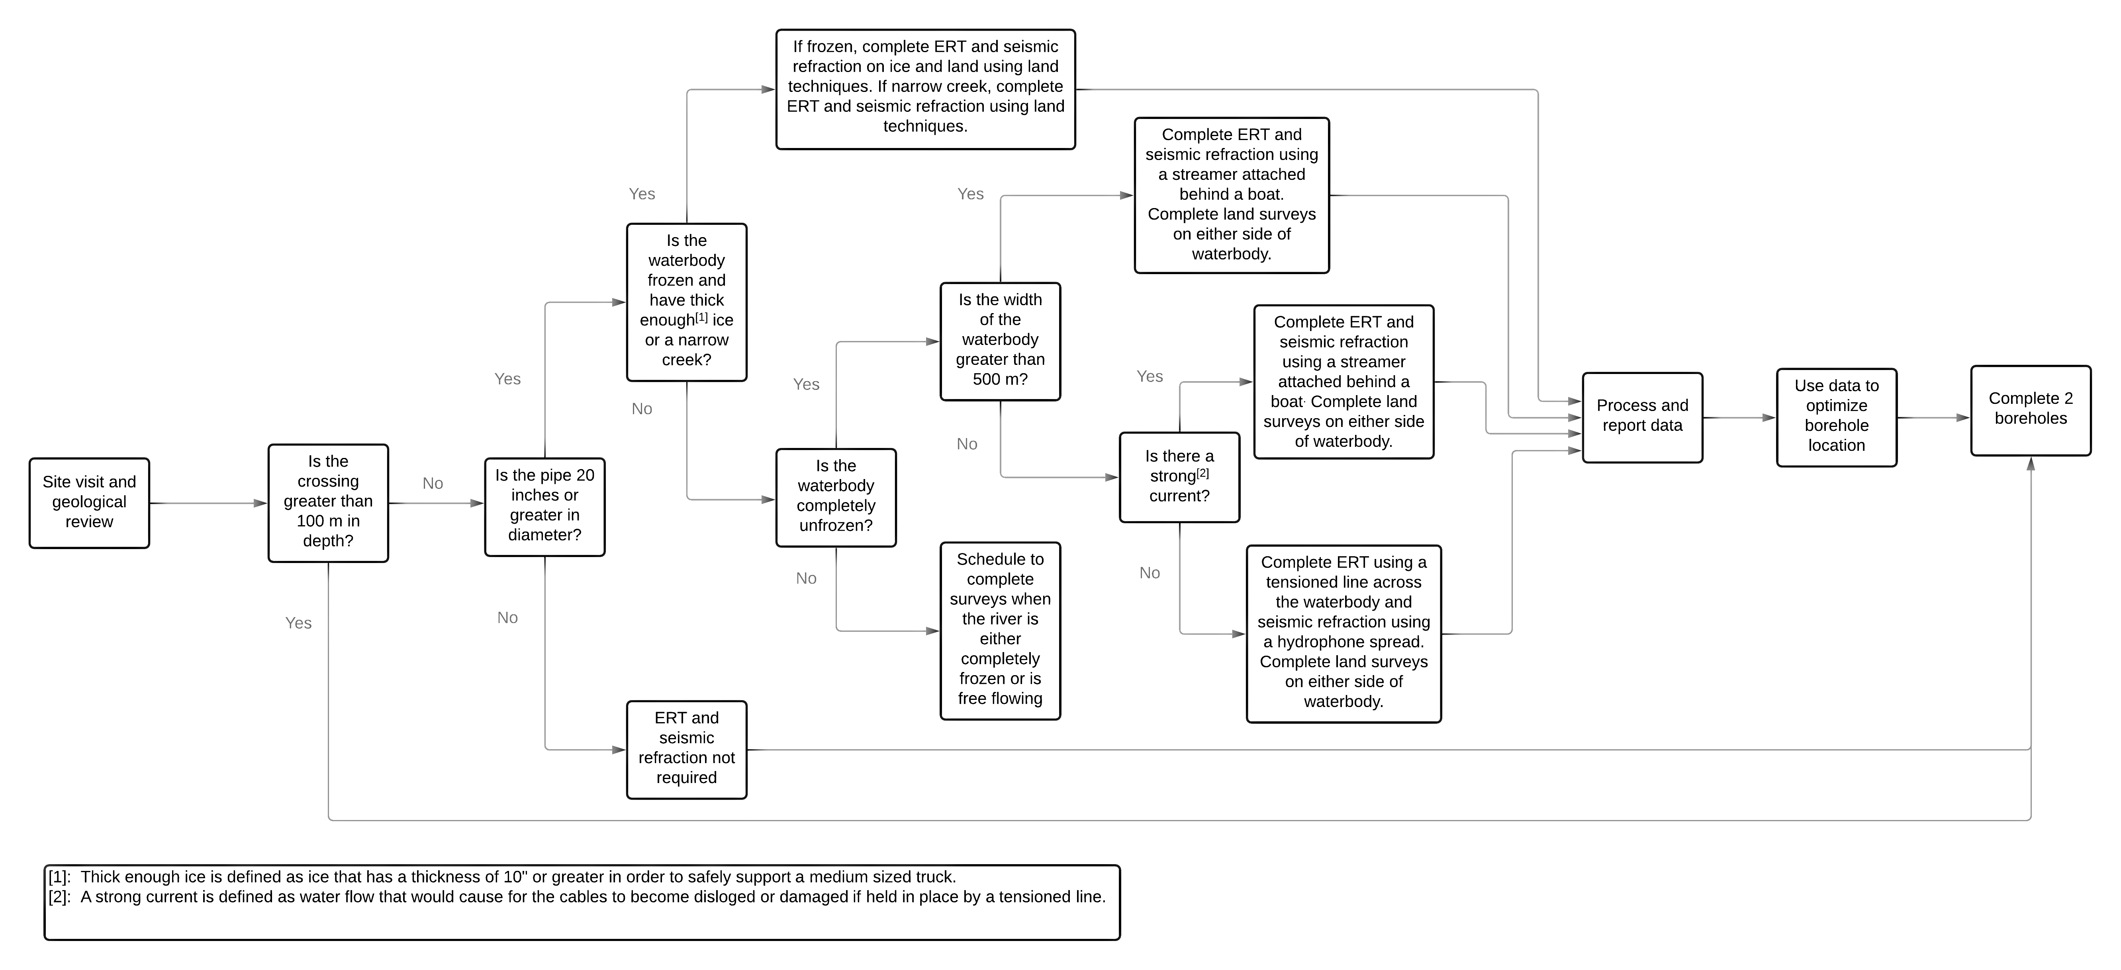
Proposed Solution
19

Slide 21
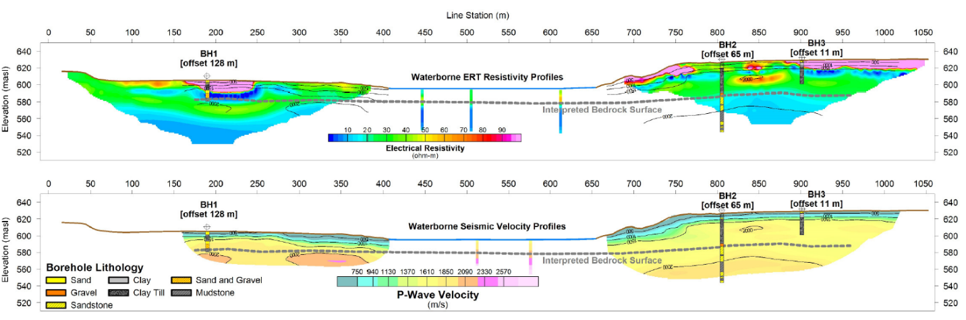
Example Survey Output
20
Notes:
Discuss the water data collected

Slide 22




Solution Limitations
Detection of Boulders
Effect of Seismic Source on Environment
Seasonality of Geophysics Methods
Continuity of Data Gathered
May not identify certain small formations
Production of seismic waves may disturb marine life or nearby animals
River must be fully thawed or frozen
Boat method captures small sections of data
21

Slide 23
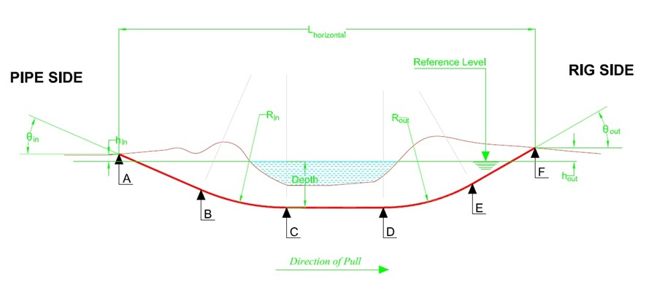

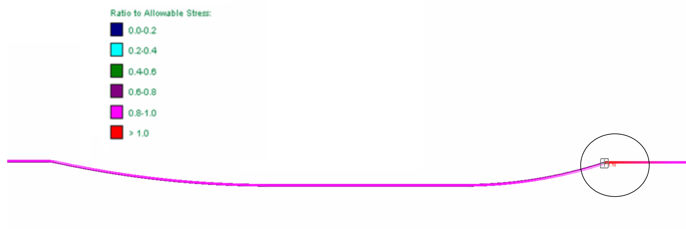

Wapiti River Crossing
FINALIZED CROSSING
HDD crossing calculator using required parameters
STRESS TEST CONDUCTED
AutoPIPE FEA Simulation
22
Notes:
Lucia

Slide 24
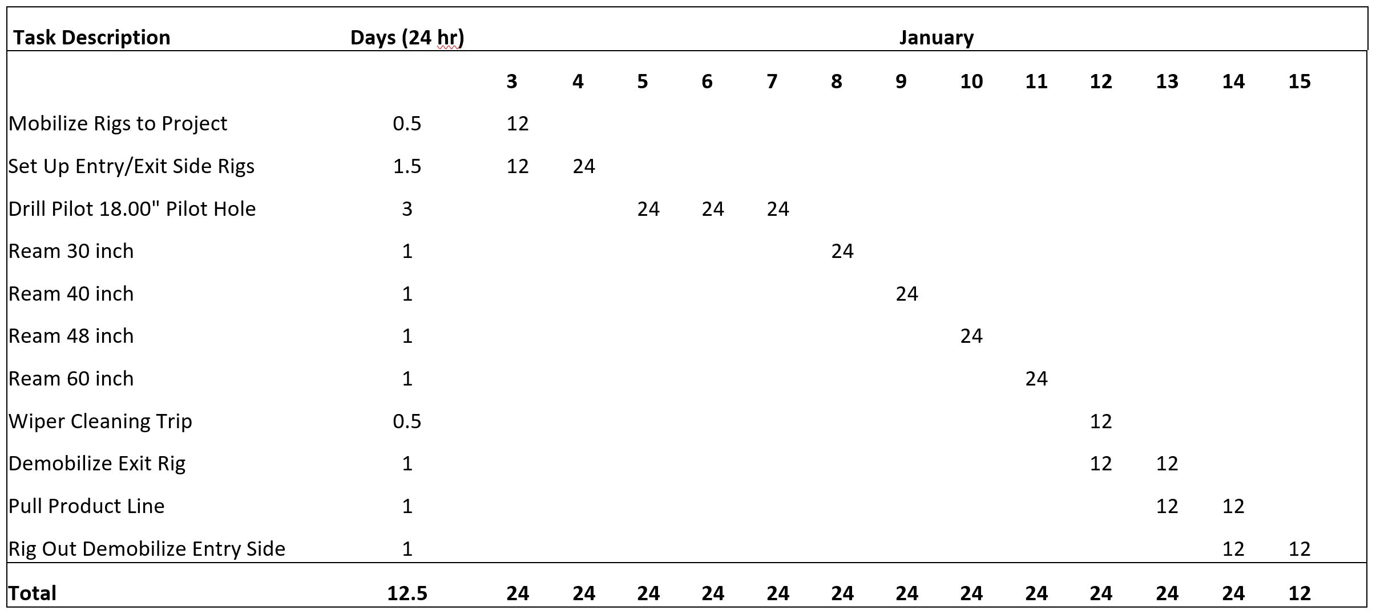
2022
Wapiti
River
_________________________________________________________________
Construction Plan
23

Slide 25
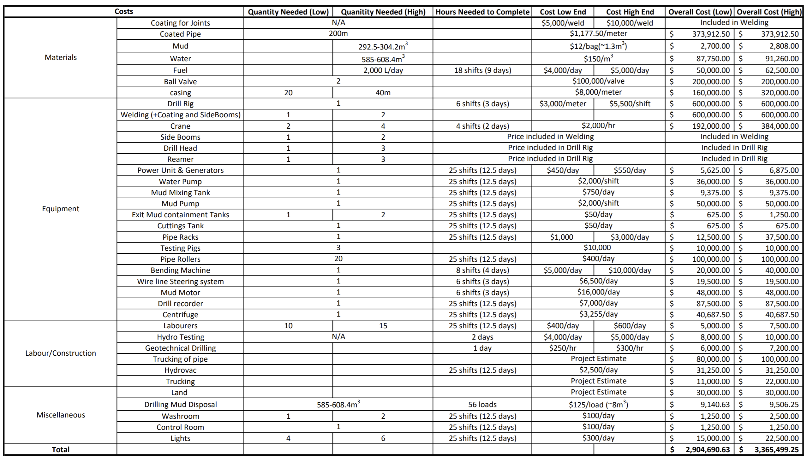
Wapiti
River
_________________________________________________________________
Cost
Estimate
24
Notes:
Lucia

Slide 26
Project Validation
Professionals
Cost Analysis
Metrics
Worked with industry professionals from the beginning of project
Reviewed all solutions with respective industry experts
Cross validated with multiple experts
Applied proposed solution back to Wapiti River crossing to review savings
Used high and low ranges for price for extra validation
Calculated cost saving
Calculated required investment cost
Created a list of metrics prior to project completion to eliminate bias
Used quantitative metrics
Assessed final solution against criteria to rank project success
25
Notes:
Maeve

Slide 27
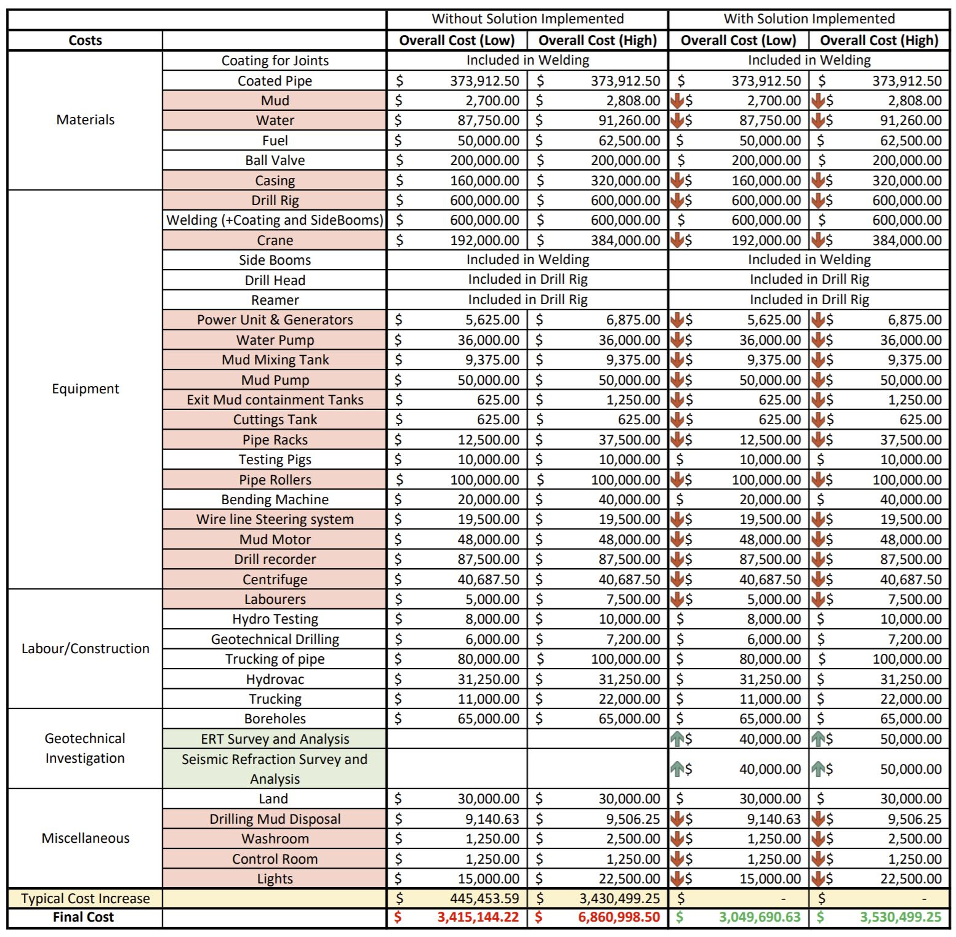
Wapiti
River
_________________________________________________________________
Cost
Estimate
With Solution
~11%
~49%
26
Notes:
Maeve

Slide 28
Feature | Level 3 | Level 2 | Level 1
External Design Metrics
Construction Cost Reduction | >8% reduction | 8-3% reduction | <3% reduction
Safety | All codes and standards will be met throughout the design and implementation of this project.
Solution Versatility | Adaptable to any HDD or pipeline construction project. | Design is only successful with Wapiti River crossing | Not feasible
Robustness of Design | Design considers possible delays and provides prevention strategies | Design considers possible delays and provides solution strategies | Design does not consider delays
Validation from Professionals | Validated by more than three industry professionals | Validated by three or less industry professionals | Validated by no industry professionals
Risk Mitigation | >8% reduction | 8-3% reduction | <3% reduction
Internal Project Metrics
Project Timelines | Deliverables completed on time or early | Deliverable two days late | Deliverable > two days late
Provide proof of concept by project end | Detailed design of crossing | High-level overview of design and crossing | No deliverable accompanying project
Stakeholder Requirements | Design meets all design criteria and constraints | Design meets some design criteria and constraints | Design meets no design criteria and constraints
Client Satisfaction | Design exceeds expectations | Design meets expectations | Design does not meet expectations
Clarity of Design | Delivery of project is clear, easy to interpret and is straight-forward to apply from an external perspective with no prior knowledge on HDD | Delivery of project is partially clear, can be interpreted but is difficult to apply from an external perspective with no prior knowledge on HDD | Delivery of project is not clear, difficult to interpret and is difficult to apply from an external perspective with no prior knowledge on HDD
Assessment Against Metrics
27

Slide 29
Conclusions and Value Analysis
MONETARY
Use geophysics to reduce risk
Recommend ERT and seismic refraction
Validated by several methods
Stakeholders
Metrics
Cost Analysis
Value:
Monetary
Environmental
Social
Addresses stakeholder concerns without compromising others’
Fewer boreholes
required
Borehole optimization
More accurate
studies and screening for projects can decrease reputational
risk
More accurate drilling mud use
Optimizes drilling path location
Optimized equipment buying and use
Avoids the use of water boreholes
Improve bid offers
Optimize amount of casing
required
Optimize
drilling fluid
composition
Less standby time
Decreased
drilling mud disposal
ENVIRONMENTAL
Less invasive for the environment
SOCIAL
28
Notes:
Maybe in validated section discuss the 11% and 49% for the pseudo project and proved the investment was worth it

Slide 30



Recommendations
Research Methods to Decrease Drilling Mud Costs
Research Underwater MASW
Create Geotechnical Information Database
4
Consider Machine Learning and AI
29

Slide 31
References
[1] | L. Drozdiak, Interview with Lindsay Drozdiak, YPAC, 2020.
[2] | Google, "Google Maps," 2020.
[3] | P. Kelly, Interviewee, Interview with Paul Kelly. [Interview]. December 2020.
[4] | "Seismic Refraction What Is It?," Surface Search Inc., [Online]. Available: https://surfacesearch.com/seismic-refraction-what-is-it/. [Accessed 26 February 2021].
[5] | A. McClymont, E. Ernst, P. Bauman and D. Parker, "What Lies Beneath - Geophysical Approaches for Assessing Trenchless Water Crossings," in 12th International Pipline Conference, Calgary, 2018.
[6] | "Subsurface data in the Oil and Gas Industry," American Geosciences Institute, 1 June 2018. [Online]. Available: https://www.americangeosciences.org/geoscience-currents/subsurface-data-oil-and-gas-industry. [Accessed 26 February 2021].
[7] | CONETEC, "MASW," CONETEC, [Online]. Available: https://www.conetec.com/services/geophysical-testing/masw. [Accessed 25 February 2021].
[8] | MASW, "What is MASW," Park Seismic LLC, [Online]. Available: http://www.masw.com/WhatisMASW.html. [Accessed 26 February 2021].
[9] | C. B. PARK, R. D. MILLER, J. XIA and J. IVANOV, "Multichannel analysis of surface waves (MASW) - Active and Passive Methods," Kansas Geological Survey, Lawrence, 2007.
[10] | "Introduction to Electrical Resistivity Imaging," Utility Survey Corporation, 11 April 2017. [Online]. Available: http://www.u-survey.com/blog/introduction-to-electrical-resistivity-imaging. [Accessed 26 February 2021].
[11] | "HDD Design Analyser," All About Pipelines, [Online]. Available: https://www.allaboutpipelines.com/HDD_Calculation/HDDDesignMethodology. [Accessed 28 January 2021].
[12] | AutoPIPE, Bentley, 2021.
[13] | J. McClennon, Interviewee, Interview with Jamie McClennon. [Interview]. 17 March 2021.
[14] | C. Lenderbeck, Interviewee, Interview with Craig Lenderbeck. [Interview]. 16 March 2021.
[15] | S. Wilson, Interviewee, Interview with Sam Wilson. [Interview]. 16 March 2021.
[16] | K. Roy, Interviewee, Interview with Kshama Roy. [Interview]. 2020.
[17] | B. McClement, Interviewee, Interview with Ben McClement. [Interview]. 12 March 2021.
[18] | K. Greco, Interviewee, Geotechnical Engineering Interview. [Interview]. 29 October 2020.
[19] | J. Gunderson, Interviewee, Interview with Jason Gunderson. [Interview]. September 2020.
[20] | C. Park, Interviewee, Interview with Choon Park. [Interview]. 12 March 2021.
30

Slide 32


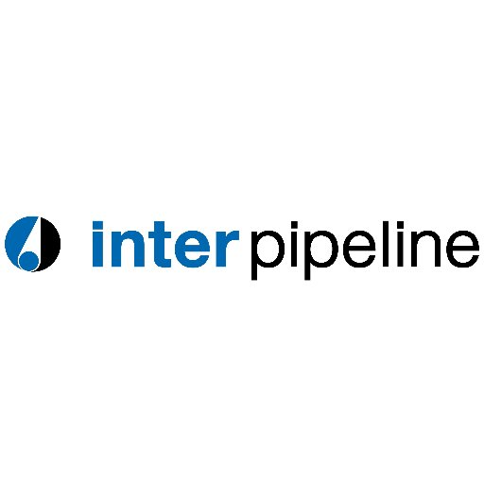
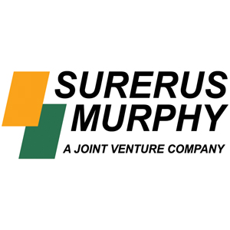



Linsday Drozdiak Katia Greco Dale Madsen Rob Purcell Craig Schell Mustafa Yulek Jason Gunderson
Kshama Roy
Northern Crescent
Mohamed Rashid Michelle Goodkey
Acknowledgments
TC Energy
Inter Pipeline
Paul Kelly Derek McLean
David Strong Trevor Lewis Emma Jane Randall
Surerus Murphy
Queen's University
Sam Wilson Craig Lenderbeck
CCI Solutions
Sallie Vest
Exxon Mobil
Jamie McLennon Des Ross
Brothers HDD
31

Slide 33
THANK YOU
ALL QUESTIONS ARE WELCOME
32

